Slide 1
Group3
Analysis of
Worldwide Life Expectancy
in the period between 2000 and 2015 Based on Statistical Regression Method Analysis
Prepared by
Bi Xiaoyang
He Enhao
Wang Qipeng

Slide 2
1
Introduction
2
Methodology
CONTENTS
Analysis On
Worldwide Life Expectancy
3
Result and Discussion
4
Extra Work and Conclusion

Slide 3
Contributions of each member
1
Bi Xiaoyang | Writing code for building models, do experiments, comparisons(MY and CN),Time series predicting and visualization, writing the literature review, methodology part of report | 33.3%
Wang Qipeng | Writing report(introduction and analysis part) and write the code of data pre-processing part[filling missing value(second method)] | 33.3%
He Enhao | Writing code of Feature selection, data pre-processing part[deleting missing value(First method)], writing report of methodology, experiment and analysis, conclusion part | 33.3%
2
3

Slide 4
1
Introduction
Analysis of Worldwide Life Expectancy in the period between 2000 and 2015 Based on Statistical Regression Method Analysis

Slide 5
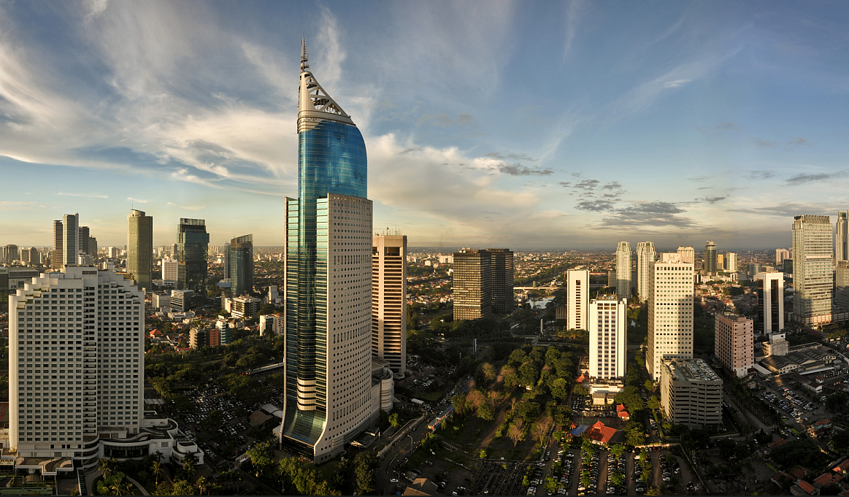
1. Do various predicting factors which has been chosen initially really affect the Life expectancy? What are the predicting variables actually affecting the life expectancy?
2. Should a developing country (i.e, Malaysia, China) increase its healthcare expenditure in order to improve its average lifespan? (It depends on how much healthcare expenditure affects life expectancy)
3. How does Infant and Adult mortality rates affect life expectancy?
4. What is the impact of schooling on the lifespan of humans?
5. Does Life Expectancy have positive or negative relationship with drinking alcohol?
Introduction

Slide 6
2
Methodology
Analysis of Worldwide Life Expectancy in the period between 2000 and 2015 Based on Statistical Regression Method Analysis

Slide 7
193 countries
from 2000 to 2015
22 columns, 2938 rows
19 predicting variables
Dataset
Country | Country
Year | Year
Status | Developed or Developing status
Life_Expectancy | Life Expectancy in age
Adult_Mortality | Adult Mortality Rates of both sexes (probability of dying between 15 and 60 years per 1000 population)
Infant_Deaths | Number of Infant Deaths per 1000 population
Alcohol | Alcohol, recorded per capita (15+) consumption (in litres of pure alcohol)

Slide 8
Percentage_Expenditure | Expenditure on health as a percentage of Gross Domestic Product per capita(%)
HepatitisB | Hepatitis B (HepB) immunization coverage among 1-year-olds (%)
Measles | Measles - number of reported cases per 1000 population
BMI | Average Body Mass Index of entire population
Under_Five_Deaths | Number of under-five deaths per 1000 population
Polio | Polio (Pol3) immunization coverage among 1-year-olds (%)
Total_Expenditure | General government expenditure on health as a percentage of total government expenditure (%)
Diphtheria | Diphtheria tetanus toxoid and pertussis (DTP3) immunization coverage among 1-year-olds (%)
Dataset
HIV/AIDS | Deaths per 1 000 live births HIV/AIDS (0-4 years)
GDP | Gross Domestic Product per capita (in USD)
Population | Population of the country
Thinness_10-19_Years | Prevalence of thinness among children and adolescents for Age 10 to 19 (%)
Thinness_5-9_Years | Prevalence of thinness among children for Age 5 to 9(%)
Income_Composition_Of_Resources | Human Development Index in terms of income composition of resources (index ranging from 0 to 1)
Schooling | Number of years of Schooling(years)

Slide 9
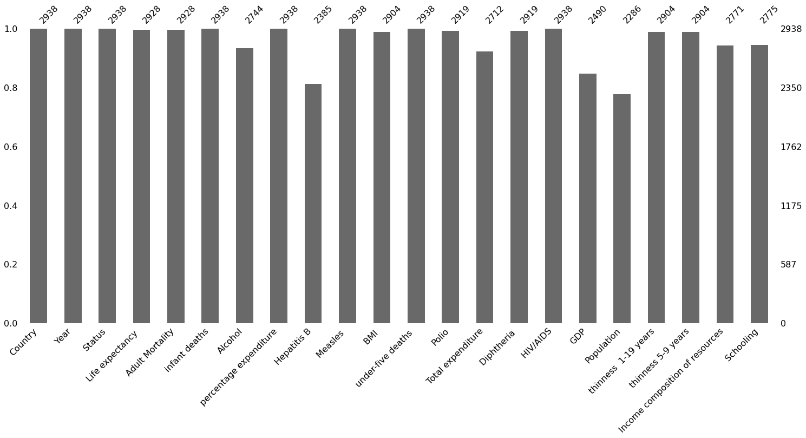
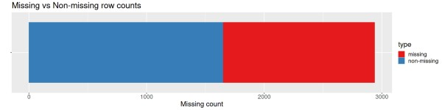
Data
Preprocessing
number of normal values in each feature
number of rows with missing values vs without ones

Slide 10
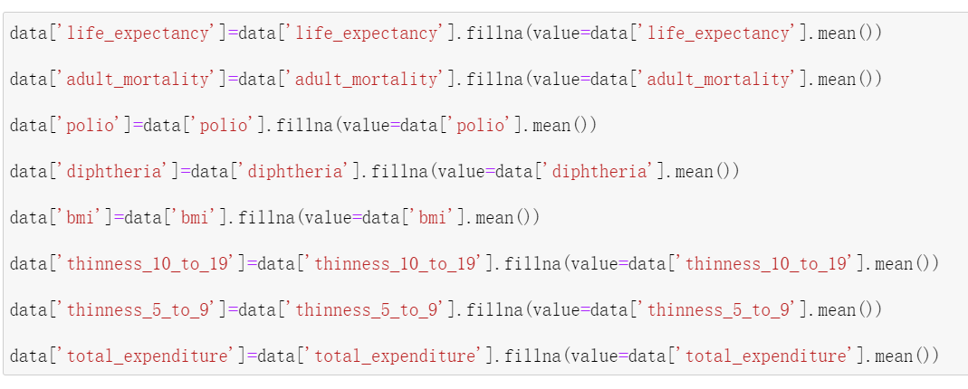
Data
Preprocessing
Code of filling these features by average

Slide 11
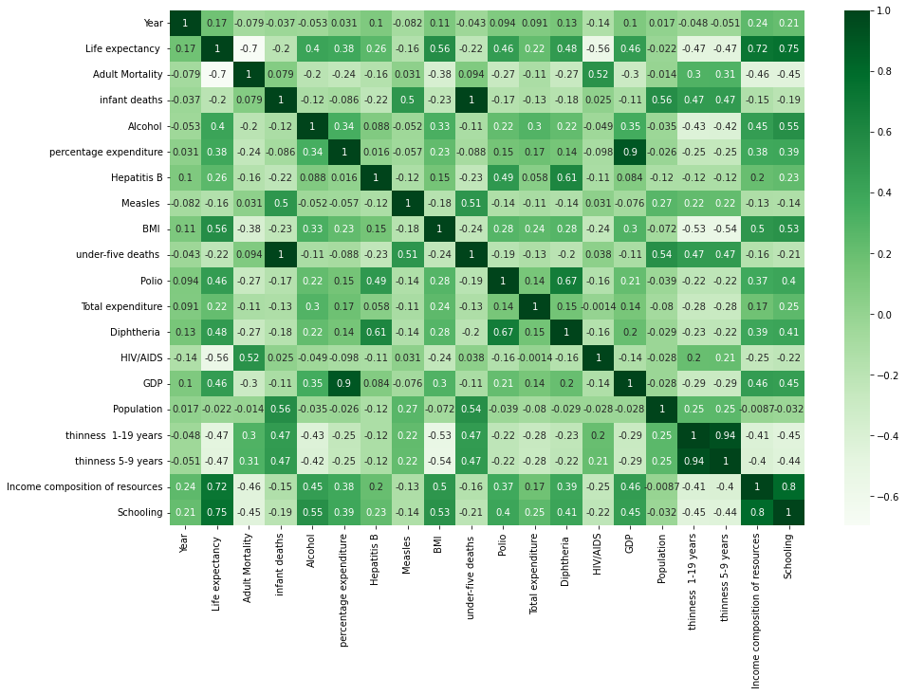
Data
Preprocessing
Correlation Matrix of the Original Dataset

Slide 12
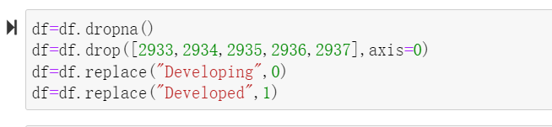
Data
Preprocessing
Code of Dropping Method

Slide 13
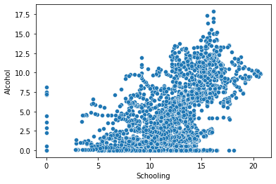
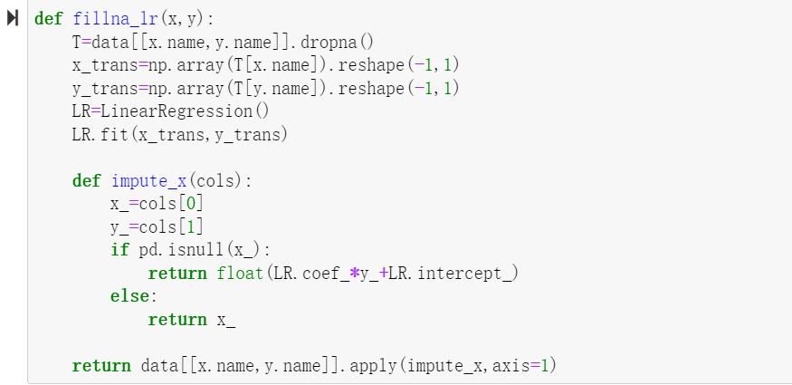
Data
Preprocessing
Relation between column ‘Schooling’ and ‘Alcohol’
number of features after pre-processing

Slide 14
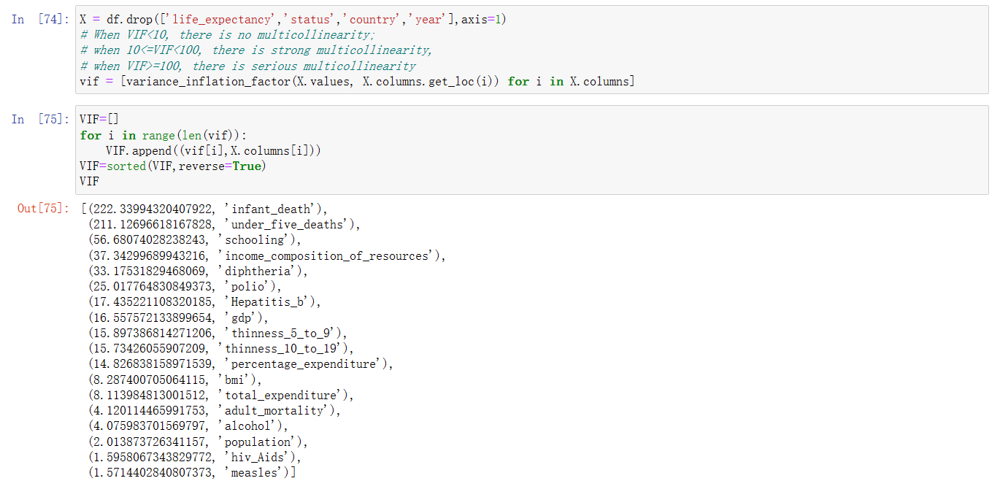
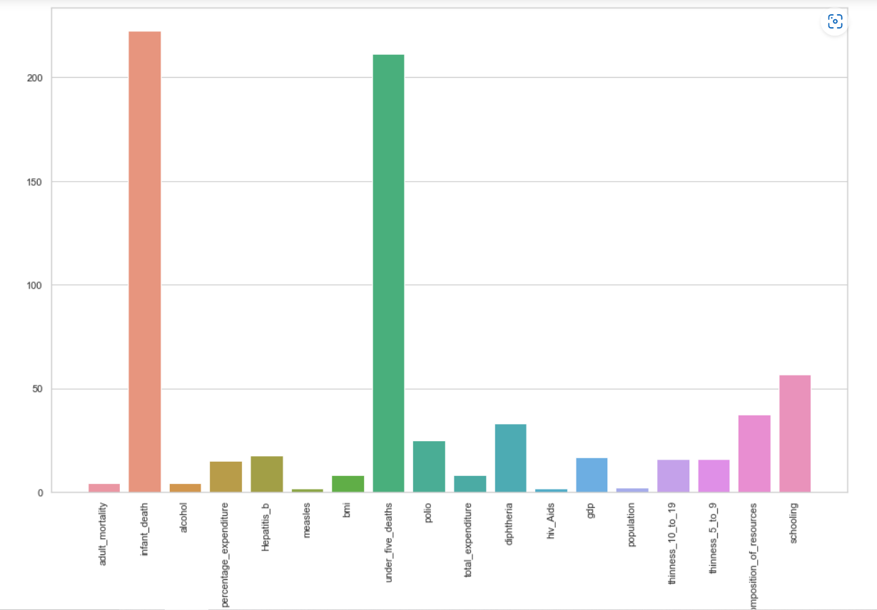
Feature
Selection
Code and Visualization implementation of VIF

Slide 15
Data
Preprocessing
Correlation Matrix of the Original Dataset

Slide 16
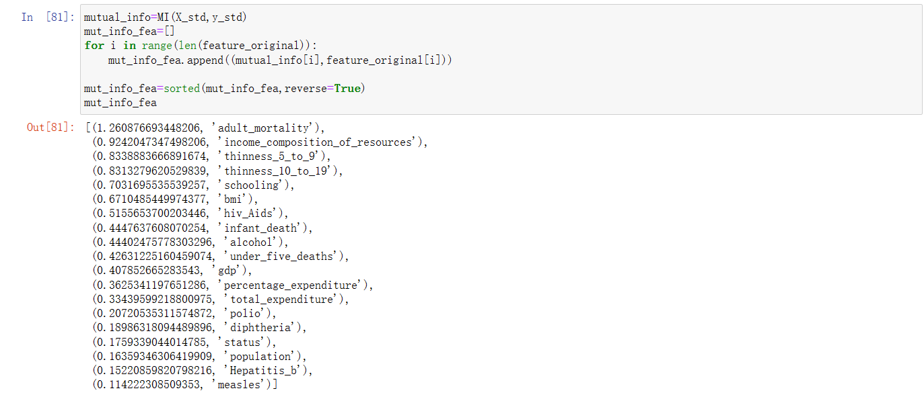
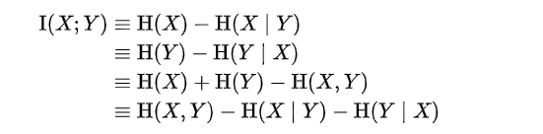
Feature
Selection
Code and result of mutual information

Slide 17
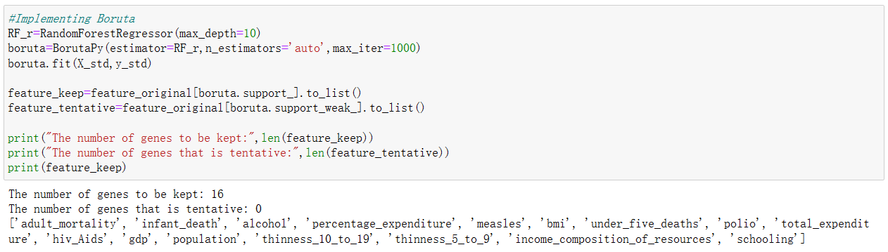
Feature
Selection
Code and result of Boruta algorithm

Slide 18
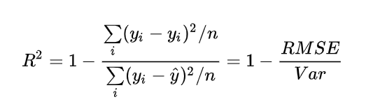
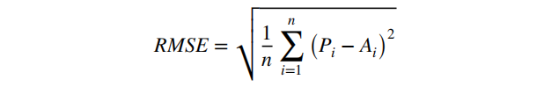
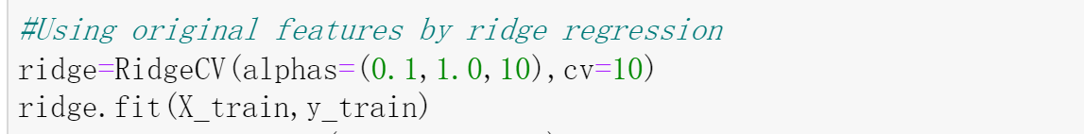
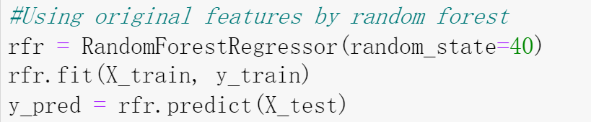
Models,
Metrics
Code implementation of Linear Regression, Ridge Regression, Random Forest, Multi layer perceptron

Slide 19
3
Result and Discussion
Analysis of Worldwide Life Expectancy in the period between 2000 and 2015 Based on Statistical Regression Method Analysis

Slide 20
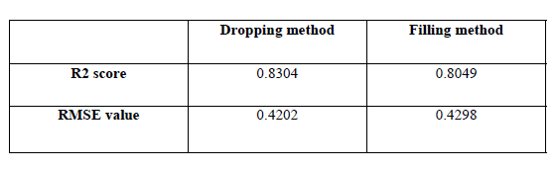
Comparing the performance of two NaN-processing methods by Linear
Regression
Experiment 1

Slide 21
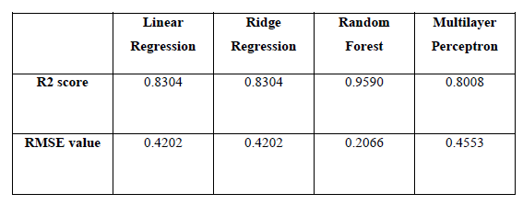
Comparing the performance of applying different regression models
Experiment 2

Slide 22
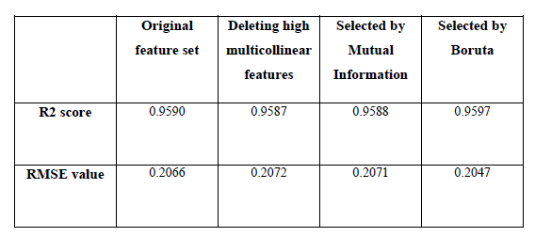
Using Random Forest to make prediction on other three feature sets
Experiment 3

Slide 23
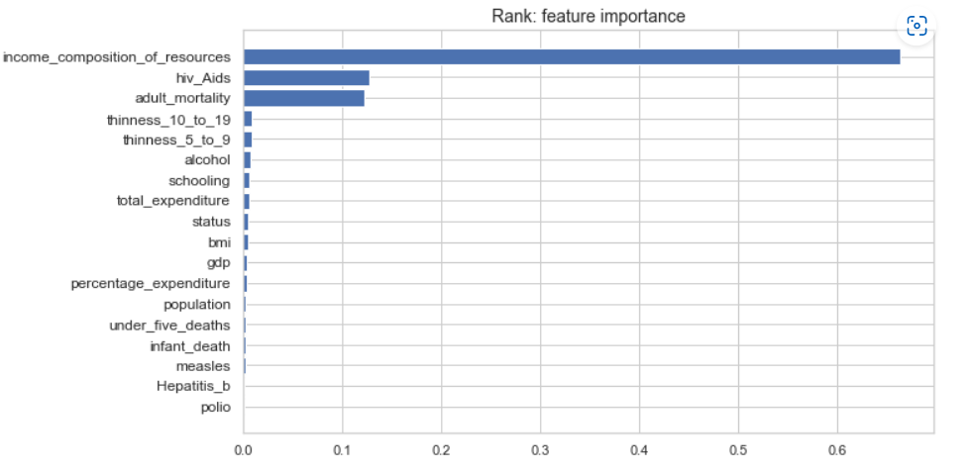
Assumptions are confirmed:
Immunization coverage of diphtheria and hepatitis_B have little effect on life expectancy.
Adult mortality and income composition of resources have highest influence on life expectancy.
Analysis

Slide 24
4
Extra work and Conclusion
Analysis of Worldwide Life Expectancy in the period between 2000 and 2015 Based on Statistical Regression Method Analysis

Slide 25
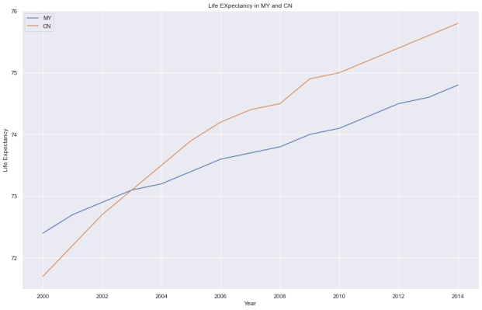
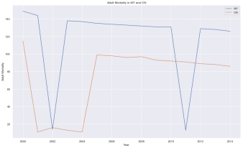
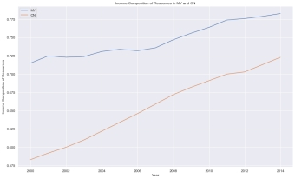
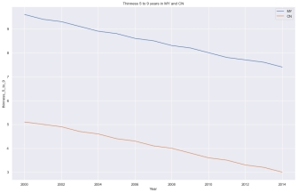
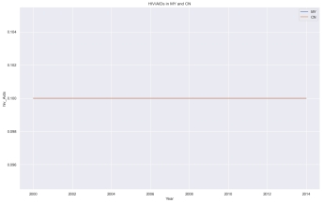
Extra Work
The trend of comparison the MY and CN in Adult mortality (top left), income composition (top right), child malnutrition rate (bottom left), HIV/AIDS mortality (bottom right)

Slide 26
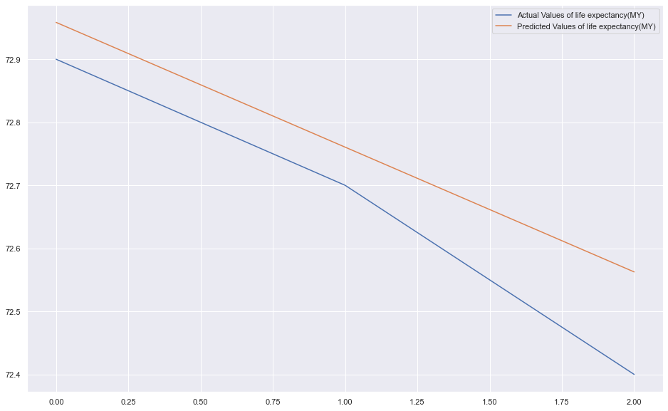
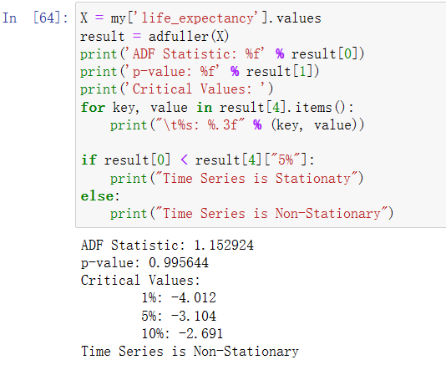
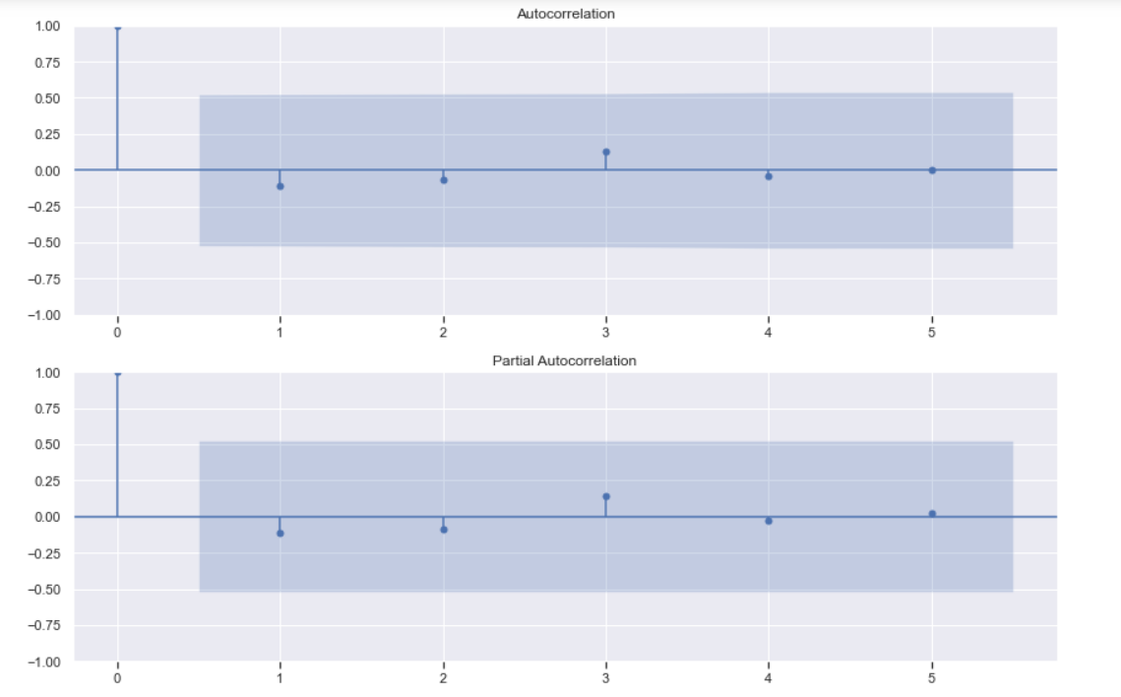
The ADF Test for our data to put in Time series Analysis
The Predicted value vs. Actual value of life expectancy in Time series Analysis and ACF/PACF plot

Slide 27
We mainly focused on exploring the relationship between predicting variables and life expectancy.
“What are the predicting variables most affecting life expectancy? “
Then we utilized three feature selection methods to obtain three different feature sets.
Experiments are conducted to confirm our assumptions and answered the core question.
Conclusion

Slide 28
Group 3
THANKS FOR YOUR ATTENTION
Instructor: Dr. Shamini Raja Kumaran

